Slide 1
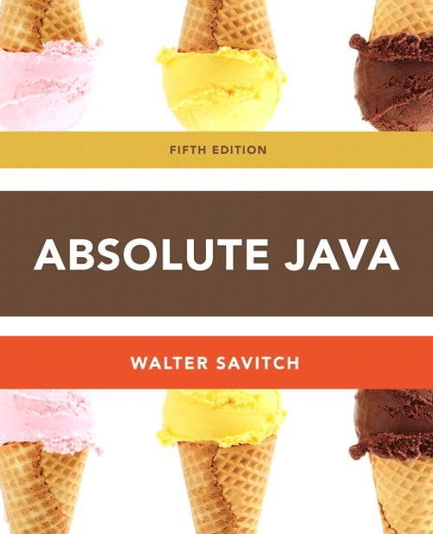
Chapter 4
Constructors Section 4.4
Slides prepared by Rose Williams, Binghamton University
Kenrick Mock, University of Alaska Anchorage

Slide 2
Constructors
A constructor is a special kind of method that is designed to initialize the instance variables for an object:
public ClassName(anyParameters){
code
}
A constructor must have the same name as the class
A constructor has no type returned, not even void
Constructors are typically overloaded

Slide 3
Constructors
A constructor is called when an object of the class is created using new
ClassName objectName = new ClassName(anyArgs);
The name of the constructor and its parenthesized list of arguments (if any) must follow the new operator
This is the only valid way to invoke a constructor: a constructor cannot be invoked like an ordinary method
If a constructor is invoked again (using new), the first object is discarded and an entirely new object is created
If you need to change the values of instance variables of the object, use mutator methods instead

Slide 4
You Can Invoke Another Method in a Constructor
The first action taken by a constructor is to create an object with instance variables
Therefore, it is legal to invoke another method within the definition of a constructor, since it has the newly created object as its calling object
For example, mutator methods can be used to set the values of the instance variables
It is even possible for one constructor to invoke another

Slide 5
A Constructor Has a this Parameter
Like any ordinary method, every constructor has a this parameter
The this parameter can be used explicitly, but is more often understood to be there than written down
The first action taken by a constructor is to automatically create an object with instance variables
Then within the definition of a constructor, the this parameter refers to the object created by the constructor

Slide 6
Include a No-Argument Constructor
If you do not include any constructors in your class, Java will automatically create a default or no-argument constructor that takes no arguments, performs no initializations, but allows the object to be created
If you include even one constructor in your class, Java will not provide this default constructor
If you include any constructors in your class, be sure to provide your own no-argument constructor as well

Slide 7
Default Variable Initializations
Instance variables are automatically initialized in Java
boolean types are initialized to false
Other primitives are initialized to the zero of their type
Class types are initialized to null
However, it is a better practice to explicitly initialize instance variables in a constructor
Note: Local variables are not automatically initialized

Slide 8
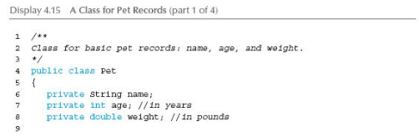
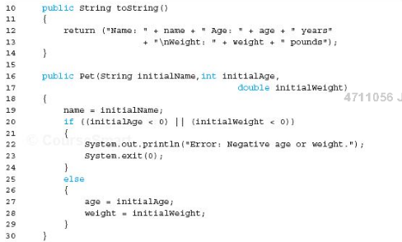

Slide 9
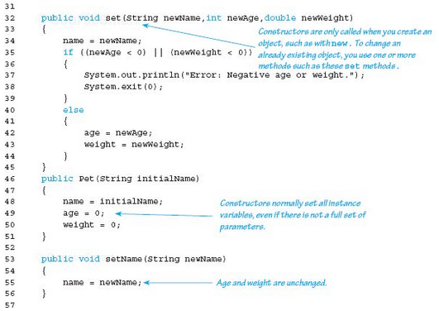

Slide 10


Slide 11
